Slide 1



Intro to Cybersecurity
Week 1
Attendance
linktr.ee/CODE.CRUNCH

Slide 2
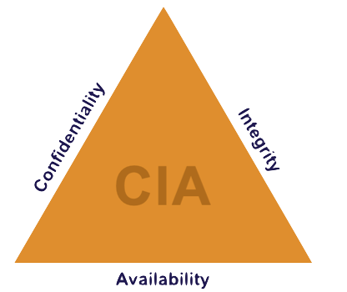
What is Cybersecurity
https://commons.wikimedia.org/wiki/File:Confidentiality_Integrity_Availability_triangle.png
Definition: The practice of protecting systems, networks, and data from digital attacks.
Goals of Cybersecurity: Confidentiality, Integrity, Availability (CIA Triad).
Importance: Safeguards personal, organizational, and national data.
Notes:
"Cybersecurity is the practice of protecting systems, networks, and data from digital attacks. This is a crucial field in today's world, where almost every aspect of our lives involves some form of digital interaction—whether it's sending emails, managing finances, or protecting critical infrastructure.
The goals of cybersecurity are often summarized by something called the CIA Triad. Let’s break it down:
Confidentiality ensures that sensitive information is only accessible to those who are authorized to see it. Think of it as protecting secrets.
Integrity ensures that data remains accurate and trustworthy, meaning no unauthorized changes can go unnoticed or uncorrected.
Availability ensures that systems and data are accessible when needed. This prevents downtime or denial-of-service attacks from disrupting operations.
Why is this important? Cybersecurity safeguards not just personal data but also organizational and even national data. Imagine the impact of a hospital's systems being hacked, a financial institution's customer records being stolen, or a government database being compromised.
By practicing good cybersecurity habits, we help protect ourselves, our communities, and our countries from the ever-growing range of digital threats."

Slide 3
Threats and Vulnerabilities
Threats: External dangers that can exploit vulnerabilities (e.g., malware, phishing).
Vulnerabilities: Weaknesses in a system (e.g., outdated software, weak passwords).
Real-World Example: Equifax data breach:
Cause: Unpatched vulnerability in web software.
Impact: Data of 147 million people exposed.
Notes:
"Now that we understand the importance of cybersecurity, let’s dive deeper into what we’re protecting systems and data from. This comes down to two key concepts: threats and vulnerabilities.
Threats
A threat is anything that can exploit a vulnerability to cause harm. Threats can be external or internal and range from individuals to malicious software. Here are a few common examples:
Phishing: Cybercriminals disguise themselves as trusted entities, often through emails or messages, to trick users into sharing sensitive information like passwords or credit card numbers.
Example: You receive an email claiming to be from your bank asking you to reset your password. Clicking the link leads to a fake website designed to steal your credentials.
Malware: Malicious software designed to damage systems, steal data, or cause disruptions. This includes viruses, worms, trojans, and spyware.
Example: Downloading an attachment from an untrusted source installs a virus that corrupts your files.
Insider Threats: This occurs when someone within an organization misuses their access to harm the company.
Example: An employee intentionally leaks sensitive client information to competitors.
Ransomware: A type of malware that locks or encrypts your data, demanding a ransom for its release.
Example: A hospital's patient records are encrypted by attackers who demand payment to unlock them, disrupting care.
Social Engineering: Attackers manipulate people into revealing confidential information, often through psychological tactics like fake phone calls or spoofed websites.
Example: An attacker pretending to be IT support tricks someone into sharing their system login credentials.
Vulnerabilities
A vulnerability is a weakness in a system or process that can be exploited by threats. Without addressing these, systems become easy targets. Here are some common vulnerabilities:
Weak Passwords: Using easily guessed passwords, like '123456' or 'password,' provides an open door to attackers.
Example: An attacker guesses a weak password to gain access to an email account.
Unpatched Software: Software that hasn’t been updated with the latest security patches often contains known bugs or weaknesses.
Example: A company using outdated software is targeted with an exploit that has already been fixed in a newer version.
Putting It Together
Threats exploit vulnerabilities to cause harm, which is why identifying and addressing these weaknesses is a cornerstone of cybersecurity.
Interactive Question for Participants: 'Think about your own digital habits. Can you identify a threat or vulnerability you might have encountered? How would you address it?'
By being aware of both threats and vulnerabilities, we take the first step toward creating stronger defenses."

Slide 4
Careers in Cybersecurity
Popular Roles:
Security Analyst
Penetration Tester
Incident Responder
Security Architect
Skills Needed: Networking, programming, problem-solving.
Career Benefits: High demand, competitive salaries, impactful work.
A Day in the Life of an Ethical Hacker | Indeed
Notes:
Popular Roles
Security Analyst: Monitors systems for suspicious activity and vulnerabilities.
Penetration Tester: Simulates cyberattacks to identify security gaps.
Incident Responder: Manages and mitigates security breaches.
Security Architect: Designs and implements secure systems and protocols.
Skills Needed
Networking: Understanding network protocols, firewalls, and intrusion detection systems is fundamental.
Programming: Languages like Python, Java, or C are useful for automation and scripting.
Problem-Solving: Essential for troubleshooting security issues and devising solutions.
Career Benefits
High Demand: Cybersecurity professionals are essential across industries.
Competitive Salaries: Reflecting the critical nature of their work.
Impactful Work: They protect organizations, individuals, and critical infrastructure from cyber threats.

Slide 5
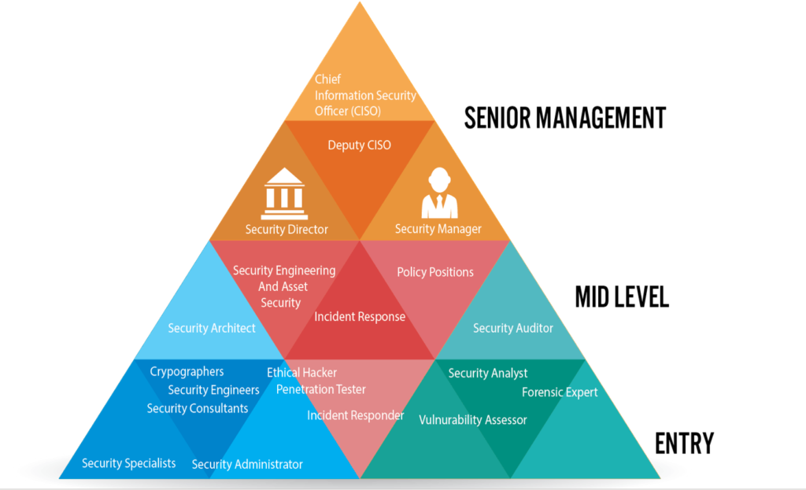
Careers in Cybersecurity
Notes:
Popular Roles
Security Analyst: Monitors systems for suspicious activity and vulnerabilities.
Penetration Tester: Simulates cyberattacks to identify security gaps.
Incident Responder: Manages and mitigates security breaches.
Security Architect: Designs and implements secure systems and protocols.
Skills Needed
Networking: Understanding network protocols, firewalls, and intrusion detection systems is fundamental.
Programming: Languages like Python, Java, or C are useful for automation and scripting.
Problem-Solving: Essential for troubleshooting security issues and devising solutions.
Career Benefits
High Demand: Cybersecurity professionals are essential across industries.
Competitive Salaries: Reflecting the critical nature of their work.
Impactful Work: They protect organizations, individuals, and critical infrastructure from cyber threats.

Slide 6
Hands-On Activity Overview
Platform: TryHackMe
https://tryhackme.com/r/module/introduction-to-cyber-security
Activity: Complete the "Introduction to Cyber Security" room.
Steps:
Follow instructor guidance for the first few sections.
Spend 15-20 minutes completing the room independently.
Share your progress and insights.
Notes:
Click on link to open try hack me dashboard for visual

Slide 7
Debrief and Key Takeaways
Key Learnings:
Importance of identifying and mitigating vulnerabilities.
Collaborative problem-solving is crucial in cybersecurity.
Next Steps:
Explore more on TryHackMe.
Think about how cybersecurity applies to everyday life. Visual: Checklist or key takeaways graphic.

Slide 8
Q&A Session

Slide 9





Attendance
Join us for the next sessions
Thursdays: 11AM – 12PM & 2PM – 3PM
Friday: 3PM – 4PM
Monday: 12PM – 1PM
RSVP lu.ma/CODECRUNCH
Your feedback helps us improve. Share your thoughts! Go to our website: go.fiu.edu/codecrunch
linktr.ee/CODE.CRUNCH

